Slide 1








Our Partner :
mODUL
Microsoft Office excel

Slide 2

Objective 1
Create and Manage Worksheet and Workbook

Slide 3
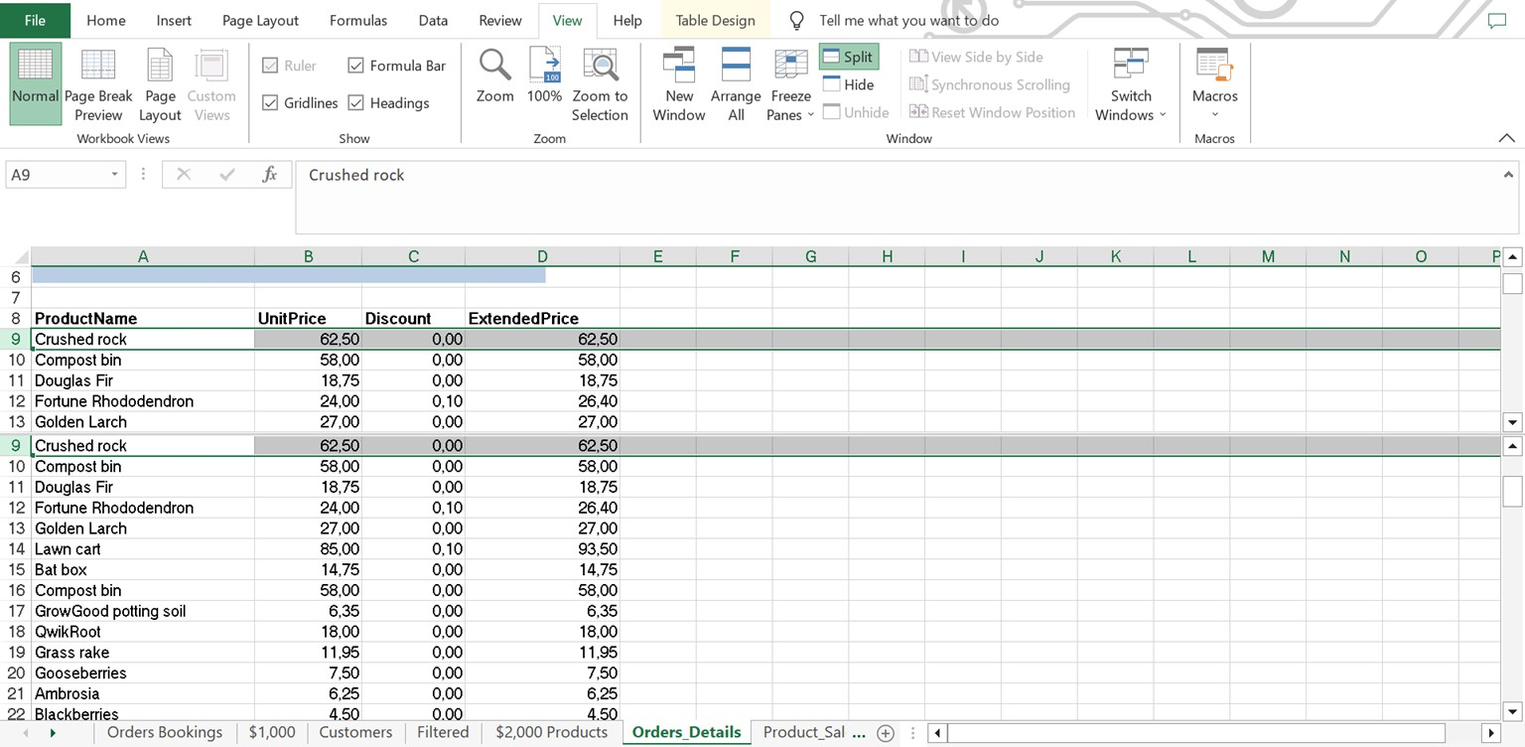
Open the Project-1 workbook and do the following :
Add a new worksheet named “New Products” to the workbook and Arrange the Worksheet so that “Products” is first
Unhide the “Order Bookings” Worksheet
Search the Company worksheet for text that is formatted with a Green color with Arial font. Change the font color to Blue to show that you found it.
Change each of the worksheet tabs to a different color from the theme color palette and Apply the Depth theme to the workbook. Verify that the worksheet tab colors change
Create a header that wil print on al the pages of the worksheet. In the left header section, enter the Current Date property; in the center section, enter the File Name property; and in the right section, enter the Page Number property and Change the center section of the header to display the name of the worksheet instead of the workbook
On The “Orders_Details” Hide rows 29 and 30 and configure the worksheet so that row 7 and the WordArt remain visible as you scroll vertically

Slide 4
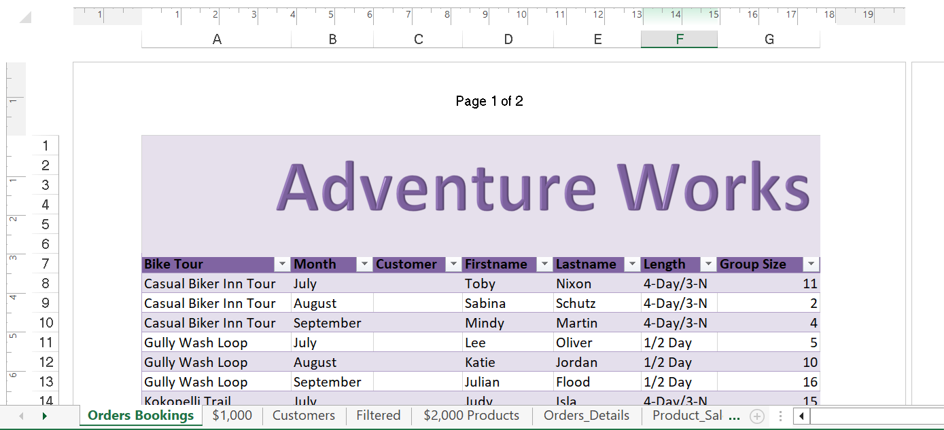
use the document Project-1 to complete the following steps :
On The “Orders_Details” Worksheet, Change the margins to 1.0” (2.54 cm) on the top and bottom, 0.75” (1.90 cm) on the left and right, with a 0.5” (1.27 cm) header and footer.
Configure the “Product_Sales” Worksheet so the
column headings in row 6 appear on all printed pages
Modify the cell formatting of cell F6 to display the text on two lines
On The “Order_Details” Worksheet. apply a number format to display the numbers in the “Unit Price” column to three decimal places
On The “Filtered” Worksheet, Navigate to the range named “Noted”, and remove the contents of the selected cells
Insert page numbering in the center of the footer on the “Orders Bookings” Worksheet using the format Page 1 of ?

Slide 5
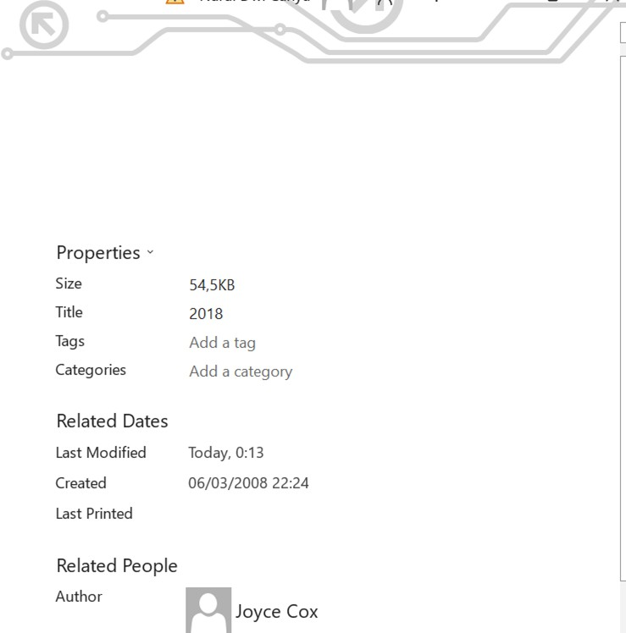
use the same document Project-1 to complete the following steps:
Add the Alternative Text Title “Used Product Sales in 2023” to the “Table13” table
Add the “2018” to the title property of the document
Add the Calculator button (which is not available on any ribbon tab) to the Quick Access Toolbar. Make it the leftmost button, and insert a separator between it and the other buttons and Create a Quick Access Toolbar for only the current workbook. Add the Insert Combo Chart, Insert Picture, and Insert Table buttons (a l available on the Insert tab). Then display the Quick Access Toolbar below the ribbon.
save as the document with the format project-1_your name

Slide 6
Open the Excel_1-2 workbook and do the folowing : Search the workbook for all instances of the word garden. Confirm that the search returns results from both worksheets.
Move to the cel at the intersection of the last active row and column in the worksheet.
Configure the worksheet to print at a Landscape orientation. Display the print preview of the worksheet to verify the settings.
Open and Display the Excel_1-4 worksheet and do the following : Freeze rows 1 through 9 so that when you scrol the rest of the worksheet, those rows are always visible.
Split the worksheet so that you can display rows 1 through 9 in the top window and scrol the budget data in the bottom window.
Attach the keywords (tags) spending and saving to the workbook.
Display the My Monthly Budget worksheet in Page Layout view.
Select the Projected Monthly Income section of the worksheet, and zoom in to display only the selected cells.

Slide 7
Objective 2
Manage Data Cells and Arrange

Slide 8
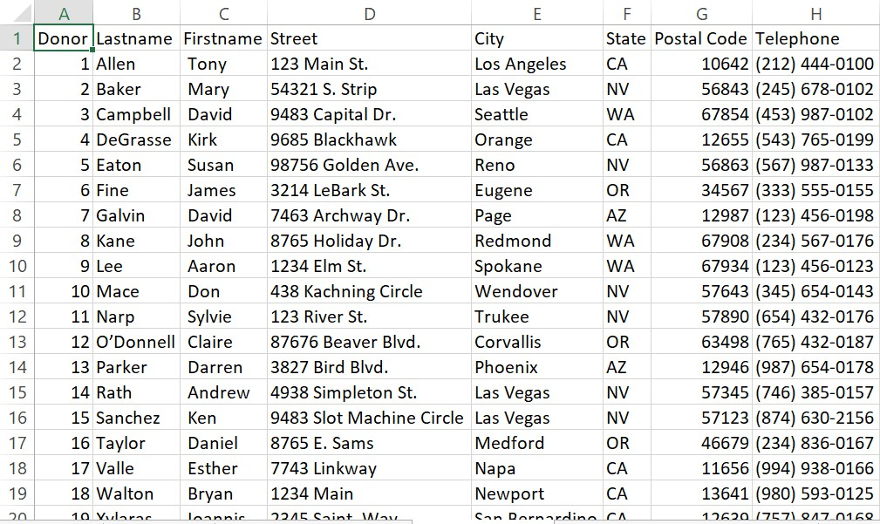

Open the Project-2 workbook and do the following :
Simultaneously replace all intances of the text “11083” with the text “11090” on Order worksheet.
Beginning at cell I1, import the data from the tab delimeted source file, contributors.txt
(please download the document first : contributors.txt )

Slide 9
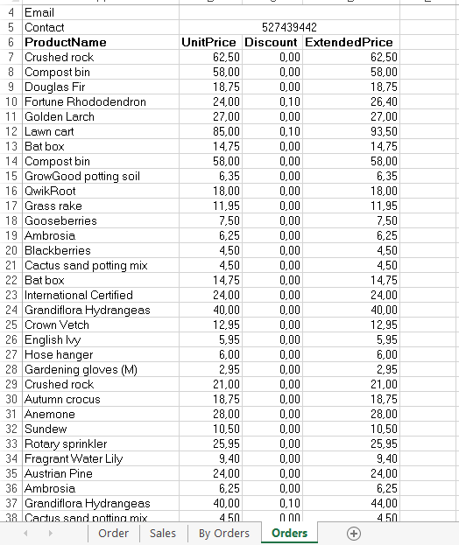

On the “Orders” Worksheet, hyperlink cell B4 to the email Address official@edutrain.com and show text email.
In cell A23, enter a hyperlink to the website located at https://edutrain.uinsgd.ac.id/ Edit the hyperlink so that the cell displays of the URL.

Slide 10
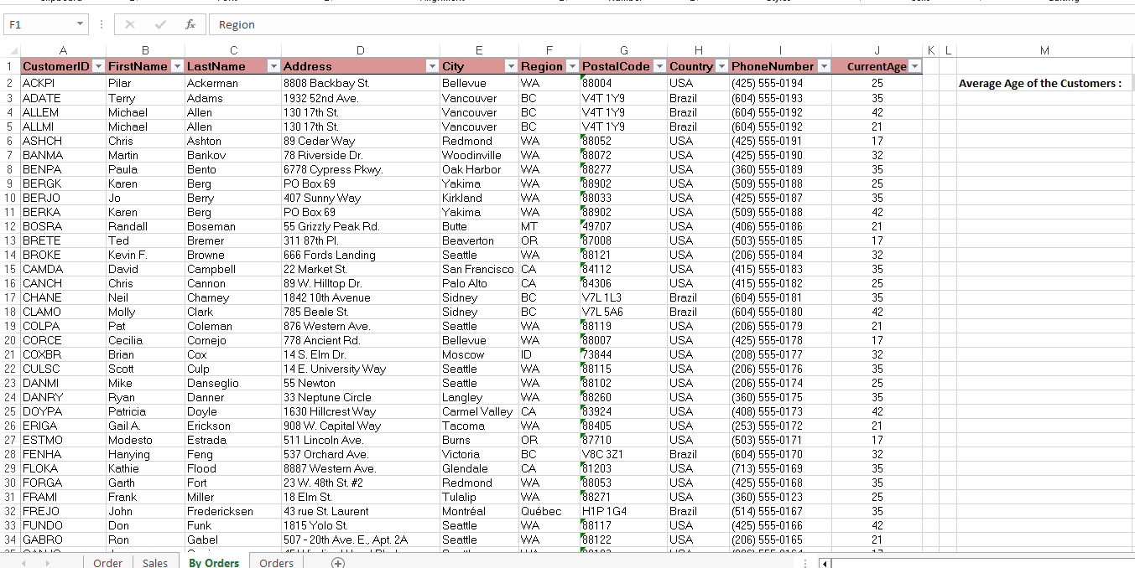
use the same document to complete the following steps :
On The “By Orders” Worksheet”, sort the table to order the records by :
the “Region” field, with customers in the USA first and customers in Brazil second.
Sort the customers in each country alphabetically (from Z to A) by the “Country” field.
Sort the customers in each state or province in descending order by the “PostalCode” field
On The “Order” Worksheet, use an automatic
On The “By Orders” Worksheet”, use an Excel data tool to remove all records with duplicate “FirstName” values from the table. Do not remove any other records.
save as the document with the format
project-2_your name
formatting method to format cells in “Extended Price” column that contain
the below-
average values by and then apply Red Fill
with
technique that
the
Dark Red Text Use a automatically updates the
formatting if
column values change.
Please download the results, check your work by comparing with this document.

Slide 11
Open the Excel_2-1 workbook, and complete the folowing tasks by using the data in cels B4:G9 of the Ad Buy Constraints worksheet
Paste only the values and formatting into the range beginning at B18.
Paste only the formulas into the range beginning at B25.
Paste only the formatting (but not the content) into the range beginning at B32.
Delete rows to move the headings to row 1.
Delete columns to move the Magazine column to column A.
Cut the data from the Mag3 row (B4:F4) and insert it into the Mag2 row (B3:F3).
Move the Cost Per Ad data to the left of the Total Cost cels.
Insert two blank ce ls in positions B8:B9, shifting any existing data down. Transpose the names in the Magazine column (cels A1:A6) to the first row of a new worksheet.

Slide 12
On the Price List worksheet, do the following :
On the Excel 2-2 workbook, display the Expense Statement worksheet, do the following :
Using the fill handle, fill cells A2:A21 with Item 1, Item 2, Item 3, and so on through Item 20.
Fill cells B2:B21 with 10, 20, 30, and so on through 200.
Fill cells C2:C21 with $3.00, $2.95, $2.90, and so on through $2.05.
Copy the background and font formatting from cell A1 to cells A2:A21. Then delete the content of cell A1 (but not the cell)
Apply the Angle Counterclockwise orientation to the headings in row 9.
Format cel K10 to display its contents as currency with a US dolar symbol and no decimal places. Then apply the same formatting to cels K11: K23.
Apply the 20% - Accent2 cel style to cels A9:K9

Slide 13
Objective 3
Create and Manage Tables

Slide 14
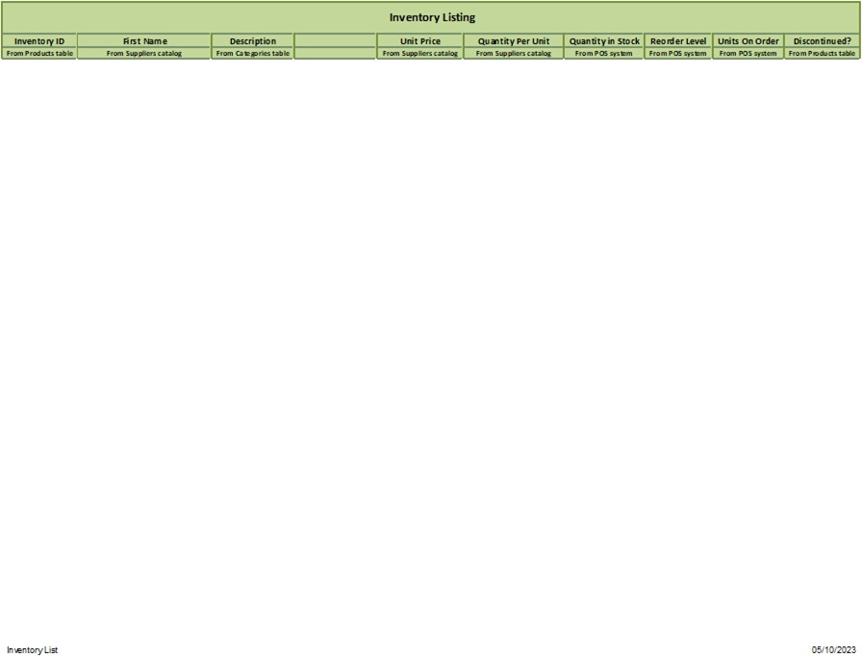
Open the Project-3 workbook and do the following :
Do the following steps on “Inventory” :
Delete column D in the worksheet
Resize columns A:I to fit their content.
Configure the “Inventory (2)” worksheet to display row 1 through row 3 on every page that is printed.
Configure the page setup options to print the worksheet gridlines.
Display the print preview of the worksheet to check your settings.

Slide 15
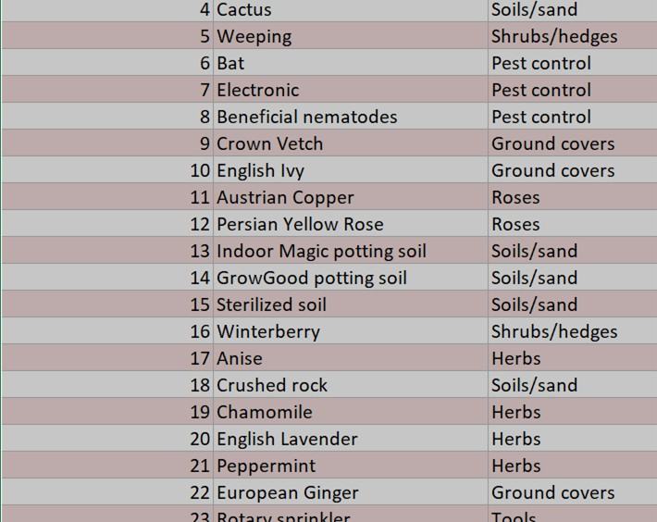
use the same document to complete the following steps :
Format the table so that every other row is shaded in Customer worksheet. Use a technique that automatically updates the formatting if you insert a new row.
Create a table from the cell range A9:G19 on “Programs” worksheet. Include row 9 as headers
Remove the table functionality from the table on
On Sales_Details worksheet Configure the table style options to format alternating rows with different fill colors Configure the table style options to emphasize the first and last columns of the table. Add a total row to the table.
Remove the formatting from the table.
save as the document with the format project- 3_your name
“Works” worksheet. Retain the cell formatting and location of the data.
Apply the Rose, Table Style Light 17 to the “Inventory” table on the table in Sales worksheet.
Create subtotals of sales amounts first by period and then by region on Details worksheet. Find the average sales by period and then by region.
Please download the results, check your work by comparing with this document.

Slide 16
Open the Excel_3-1 workbook. On the Order Details worksheet, use conditional formatting to do the following to all the values in the Extended Price column:
On the Sales By Region worksheet, create subtotals of sales amounts first by period and then by region.
Find the average sales by period and then by region.
Apply the 3 Arrows (Colored) icon set. (Keep the default settings.)
Add blue data bars to the column. (Keep the default settings.)
Fill all cells in the column that contain values of greater than $100 with bright ye low.
On the MarApr worksheet, in column P, summarize the data for each day of March by using a Line sparkline.
Apply the Sparkline Style Accent 6, Darker 25% style.
Display all the data markers without placing emphasis on any specific type of data marker.

Slide 17
Open the Excel_3-2 workbook, on the Sales worksheet, do the fo lowing:
Change the table style to Table Style Medium 19.
Configure the table style options to format alternating rows with different fi l colors.
Configure the table style options to emphasize the first and last columns of the table.
Add a total row to the table.
Change the row name from Total to Average.
Modify the cels in the row to calculate the average sales for each month and for the year.
On the Bonuses worksheet, do the folowing: Remove the formatting from the table

Slide 18
Objective 4
Perform Operations with Formulas and Functions

Slide 19
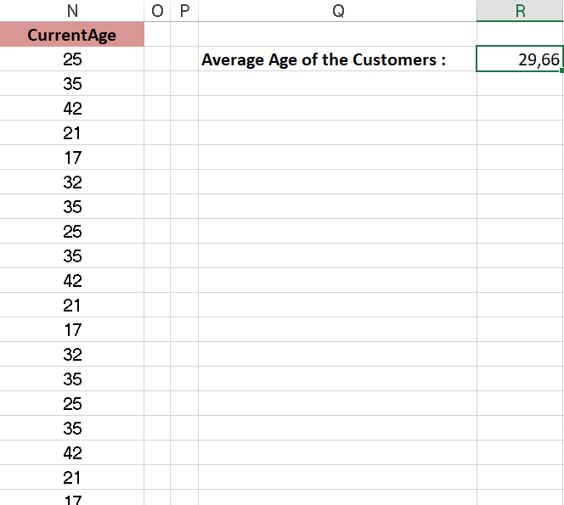
Open the Project-4 workbook and do the following :
The Discount price is 95 percent on the price. Modify column F to show the discount price for each ProductID on “Order Details” worksheet.
Enter a formula in cell H1 on Summary Worksheet that uses an Excel function to return the “Order Total” value of the individual order that has the highest “Order Total” value.
On The “Sales By Region” Worksheet, enter a formula in cell R2 on the table “Table_of_Customer” that uses an Excel function to return the average age of the customers based on the values in the “CurrentAge” column.

Slide 20
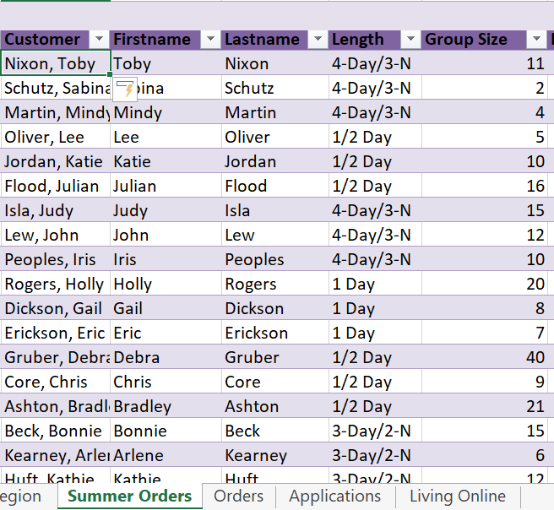
use the same document to complete the following steps :
In Cell N3 on the “Summer Orders” worksheet. Insert a function that calculates the number of groups containing 12 or more people even if the order of the rows is changed.
In Cell N4 on the “Summer Orders” worksheet. Insert a function that calculates the total amount of sales from the “Total” Column for groups containing 12 or more people even if the order of the rows is changed.
In Cell C2 on the “Summer Orders” worksheet. Insert a function that joins the customer “Lastname” to the customer “Firstname” separated by a comma and space.

Slide 21
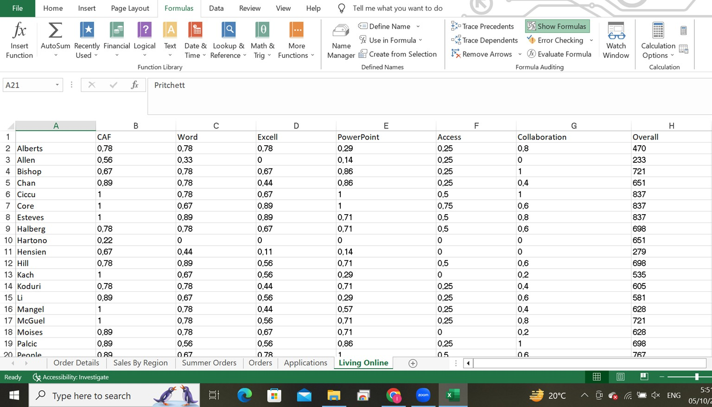
use the same document to complete the following steps :
In cell E2 of the “Orders” worksheet, use a function to put a copy of cell D2 so that only the first letter is capitalized
Add a function to cell I2 in the “Applications” worksheet that will display the word “Yes” if the value in cell H2 is higher than 719, otherwise, display the word “No”. Fill the cell in Column I to show whether or not each student passed
Display the formulas that are in the cells of the “Living” worksheet
save as the document with the format project- 4_your name
Please download the results, check your work by comparing with this document.

Slide 22
Open the Excel_4-1c workbook, display the Seasonal worksheet, and do the folowing:
In cell B18, create a formula that returns the number of non-empty cels in the Period range.
In cell C18, create a formula that returns the average value in the Sales range.
In cell D5, create a formula that returns the lowest Sales value for the Fall period.
On the Sales By Category worksheet, in cells C95, C101, and C104, calculate the sales total for each category by using a relative cell range reference.
In cell C86, calculate the Cacti sales total, using an absolute cell range reference.

Slide 23
Objective 5
Create Charts and Objects

Slide 24
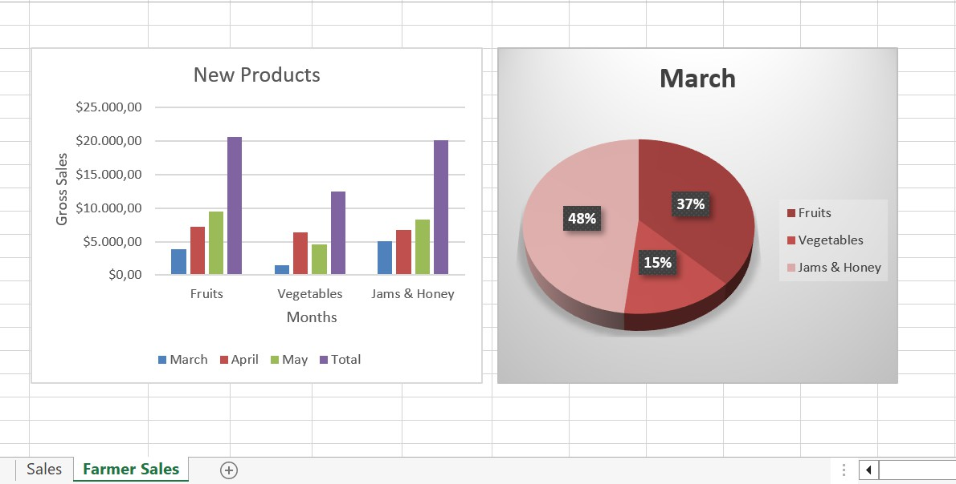
Open the Project-5 workbook and do the following :
Use the data in the “Products” and “Total” columns only to create a 3-D Pie chart. Position the new chart to the right of the column charts. use Sales worksheet
Add the title “New Products” to the column chart. Label the vertical axis “Gross Sales” and the horizontal axis “Months”. use Farmer Sales worksheet
Apply Style 3 and Monochromatic color 2 (Monochromatic Pallette 2) to the 3-D Pie Chart. Switch the rows and columns of the chart.

Slide 25
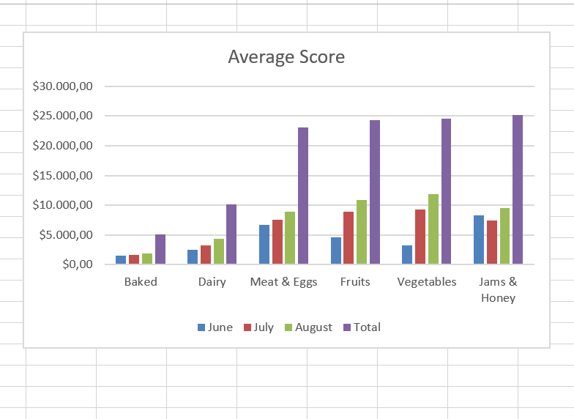
use the same document to complete the following steps :
On the “Sports Program” Worksheet, Insert a Column Sparklines for each sport that shows the enrollment for the past five years
Add a Column sparkline in the Passed Heading Column in the “Applications” Worksheet that will represent the numbers in cells B2:G30
Add the cells B32:G32 to the “Test Results” chart in the “Applications” worksheet. Name the series “Average Score”
save as the document with the format project- 5_your name
Please download the results, check your work by comparing with this document.

Slide 26
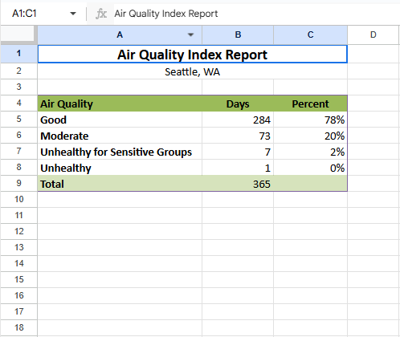
Open the Excel_5-1 workbook and do the folowing:
Plot the data on the Seattle worksheet as a 2-D Pie chart on that worksheet.
Plot the data on the Sales worksheet as a simple two- dimensional column chart
On the Fall Sales worksheet, do the folowing:
Switch the rows and columns of the chart.
Change the October sales amount for the Flowers category to 888.25 and ensure that the chart reflects the change.
Expand the data range plotted by the chart to include November, so that you can compare sales for the two months

Slide 27
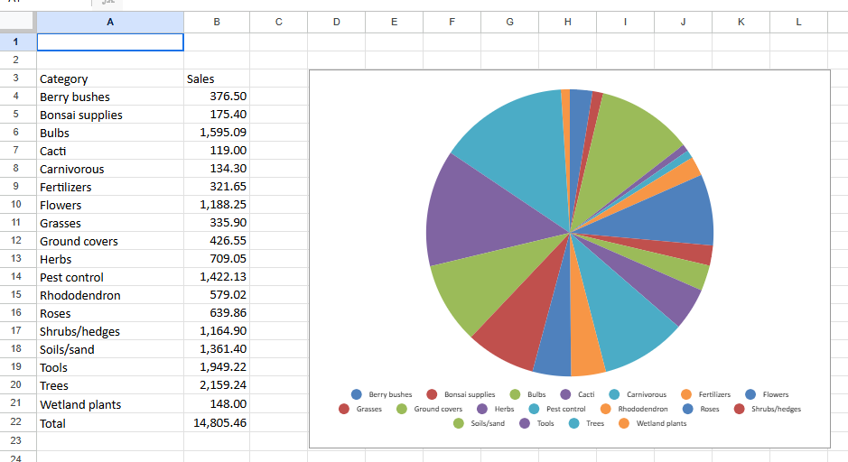
Open the Excel_5-2 workbook, display the Sales worksheet, change the pie chart to a 3-D Clustered Column chart. Apply Layout 1, Style 7 to the chart.
Apply the Subtle Effect – Olive Green, Accent 3 shape style.
Increase the size of the chart until it occupies ce ls A1:L23 Move the chart to a new chart sheet named Sales Chart.
On the Seattle worksheet, add the title Air Quality Index Report to the chart. Add data labels that show the percentage of the whole that is represented by each data marker

Slide 28
Open the Excel_5-3a workbook, display the Summary sheet, insert the Excel_5-3b logo in the upper-left corner of the sheet.
Insert a text box on the sheet. Configure the text box to be three inches wide and three inches high, and align it below the heading “Our Prediction.”
Insert the content of the Excel_5-3c text file into the text box. Format the text in 20-point orange Candara font, and center it in the text box.
Add alternative text to the logo, using the title the description Company logo and Cartoon image of a person wearing an airplane costume

